Slide 1
Employment, Security, and Development: Challenges for Colombia
Joseph E. Stiglitz
Bogota
November 2009

Slide 2
The Global Context
While the world has pulled back from the precipice and “officially” the recession in the U.S. and much of Europe is over, unemployment is likely to remain high, and growth is likely to remain weak for an extended period of time: a “Japanese-style” malaise
  Many bumps in the road
  Both for financial markets and the rest of the economy

Slide 3
Asia has staged a strong recovery
But prospects of addressing global imbalances remain weak
Developing countries need to prepare themselves for adjusting to this new “normal”
Especially important for countries that have faced high levels of unemployment

Slide 4
Unemployment
Has long been higher in Colombia than elsewhere in Latin America
  During late 1990s crisis, rose close to 20%
But increases in this crisis have made it highest rate in Latin America—12.8%
Of those “employed,” 46% were “under-employed”
  New part-time workers especially strong in recession

Slide 6
Jobless Growth
Flip side of high productivity growth
Between Dec 2002 and Dec 2008, GDP grew 36.4%, employment 7.9%
  In agriculture, in same period, output grew by 19%, employment fell 5.5%
  In manufacturing, from 1998 to 2008, output increased by 23%, employment fell by 13%
Many jobs created were “low quality,” informal services
  1 million self-employed out of 1.3 million new jobs

Slide 7
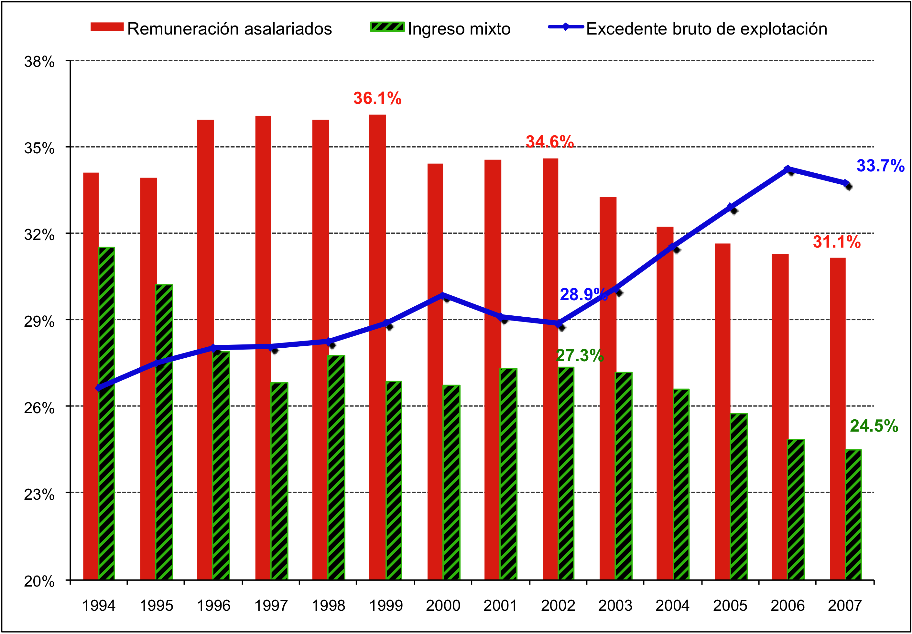
Weak Wages
5 percentage point increase in share of profits
Wages
Mixed Incomes
National Income
Notes:
a rising proportion of profits in national income (excedente bruto de explotacion in the figure below), which increased by 5 percentage points during the recent boom, as wages (remuneracion asalariados) and mixed incomes (ingreso mixto) fell.

Slide 8
Unemployment and Security
Two way relationship
But in past, stronger relationship in one direction: unemployment causes violence
Reduction in violence has not led to increase in employment

Slide 9
Explanations
Minimum wage
  Not increased substantial in pesos: 5% since 2003, adjusted for inflation
Labor market inflexibilities
  Were reduced
Increasing social cost of employment
  Not increased substantially

Slide 10
Increased Cost of Labor Relative to Capital
Tax policy
Real Exchange rate
  Highly volatile—but for importing capital goods, what matters is high points
  Strong appreciation since 2003

Slide 11
Explaining Exchange Rate Changes
Short term—capital movements
  Exogenous shock
  Depreciation after Lehman Brothers global phenomena
  Back to pattern of appreciation
Long term—natural resource curse (Dutch disease)
  Employment creation common problem for natural resource exporter

Slide 13
Solutions
Reform Tax Policy to encourage employment
Exchange rate interventions
  Capital inflow tax to stabilize exchange rate
  Exchange rate interventions to depreciate currency
    Part of explanation of East Asia’s success
    One of acceptable instruments of industrial policy under WTO
    Broad-based nature has distinct advantages

Slide 14
Problem
Bilateral Trade Agreement with US presents problems
  Not really a free trade agreement
    US continues to subsidize agriculture
    And intervenes in many areas besides trade (investment, intellectual property)
      Imposes intellectual property regime that even America is now rejecting
  Job destruction in agriculture

Slide 15
Bilateral Investment Agreement
Not balanced—rights without responsibilities
Imposes huge risks on countries (Indonesia, Argentina)
Process of adjudication not up to 21st century standards of justice
Restricts ability to impose capital controls
  Worse than other bilateral agreements

Slide 16
Response to Crisis
Those countries that responded to crisis with large fiscal and monetary measures have been most successful in responding to crisis
  Smallest increase in unemployment
  Quickest recovery
  Difficult for small, open countries

Slide 17
Stimulus
Worries about deficits exaggerated
What matters is a country’s balance sheet—assets and liabilities
  Debt financing creates a liability
  But if spending is for infrastructure, education, or technology, there is a corresponding asset
  High return assets make a country stronger in the long-run and maintain growth in the short-run
  Colombia, like most other countries, needs to prepare for climate change

Slide 18
Restructuring the
Colombian Economy
Those countries that had a diversified export base have also weathered the storm best
  Asia is quickly recovering from crisis
Those countries that have had active industrial policies (Brazil, East Asia) have also done better, both in the short-run and the long
  Including export-oriented industrial policies
  Have been a central part of all successful economies
  Both in Asia and in Latin America

Slide 19
Industrial Policies
Finance
  Through development banks
Targeted government assistance
Public/private partnerships
  Including at local/regional levels
Important to encourage local entrepreneurship
  Too many countries have put excessive focus on foreign direct investment
  Need balance

Slide 20
Avoiding Dutch Disease
Not just a matter of exchange rate management
High volatility as a result of volatility of commodity prices
  High economic cost of volatility
  Need to manage through stabilization funds

Slide 21
GDP is especially bad measure of output for natural resource country
  Doesn’t reflect sustainability
  Doesn’t reflect depletion of natural resources and degradation of environment
  Natural resource countries are often marked by high inequality—GDP per capita does not tell what is happening to median income
    Problem in both U.S. and Colombia
    U.S. median income falling, while GDP per capita increasing

Slide 22
Unless assets below the ground are converted into assets above the ground, country will be poorer

Slide 23
A New Agenda for Colombia
Balanced role between markets and government
  Big lesson of crisis: markets are not self-correcting, often not efficient
  Financial markets often fail to allocate capital in ways that promote growth and stability
    Often fail to manage risk well
    Engage in anti-competitive practices (stifling creation of an efficient electronic payments system)
    Often engage in predatory lending and other exploitive practices
    Regulation can contribute to growth and stability—and even “good” innovation
      Most of their innovation was circumventing accounting, financial, and tax rules and regulations
      Didn’t innovate in ways to help people manage risk or to improve efficiency of resource allocation

Slide 24
Other Roles of Government
Social protection—without protectionism
Macro-policies focused on stability, growth, and employment creation
Micro-policies that promote education, technology (“putting people first”—including focusing on employment)
In every successful economy, markets have been at the center, but government has played a pivotal role in each of these areas

