Slide 1
Crisis, Contagion, and the Need for a New Paradigm
Imagining an Economics That Works
Joseph E. Stiglitz
Lindau
August 26, 2011

Slide 2
Failures of Modern Macro-economics
Didn’t predict the financial crisis
  Standard models assert that bubbles can’t happen
  Standard models assert that shocks are exogenous
    Key “disturbance” to the economy was endogenous
  Policy frameworks suggested that (a) keeping inflation low was necessary, and almost sufficient, for stability and growth; (b) government didn’t have instruments to prevent bubbles; (c) cheaper to clean up mess after bubble broke
Even after bubble burst, economists claimed effects “contained”
  because of diversification
  because markets have good “buffers”

Slide 3
Failures (cont.)
Responses to crises (based on advice from economists) have clearly been inadequate
  High unemployment 4 years after beginning of recession
  Standard models didn’t focus on credit—and therefore didn’t have much to say on repairing credit system
    But theory of banking provided micro-foundations (including incentives of banks and bankers)
    Policies ignored lessons of this literature (Greenwald-Stiglitz, 2003)
  Even less to say on inherent deficiencies in securitization
    Questionable improvements in risk diversification
    Unambiguous attenuation of incentives (selection, monitoring, enforcement)
    Some market participants took advantage of information asymmetries
    Remarkable testimony to inefficiency, irrationality of markets that market participants did not recognize these (and other) problems
      Including risk of increased leverage
      Market didn’t seem to learn lesson of Modigliani-Miller

Slide 4
Failures (cont.)
Moreover, countries that have had highest persistent unemployment include those with allegedly most flexible labor markets (e.g. US), in contradiction to standard theory
  But consistent with earlier studies of volatility
    Easterly, W., R. Islam, and Joseph E. Stiglitz, 2001a, “Shaken and Stirred: Explaining Growth Volatility,” in Annual Bank Conference on Development Economics 2000, Washington: World Bank, pp. 191-212.
    —— , ——, and —— , 2001b, “Shaken and Stirred: Volatility and Macroeconomic Paradigms for Rich and Poor Countries,”, in Advances in Macroeconomic Theory, Jacques Drèze (ed.), IEA Conference Volume, 133, Palgrave, 2001, pp. 353-372.

Slide 5
Failures (cont.)
There were large losses associated with misallocation of capital before the bubble broke. It is easy to construct models of bubbles. But most of the losses occur after the bubble breaks, in the persistent gap between actual and potential output
  Standard theory predicts a relatively quick recovery, as the economy adjusts to new “reality”
    New equilibrium associated with new state variables (treating expectations as a state variable)
    And sometimes that is the case (V-shaped recovery)
  But sometimes the recovery is very slow
    Persistence of effects of shocks
    Explained by slow recovery of balance sheets (Greenwald-Stiglitz, 1993, 2003)
    But current persistence is greater than can be explained by these models

Slide 6
Understanding what has happened
There have been large (and often adverse) changes in the economy’s risk properties, in spite of supposed improvements in markets
  Moving from “banks” to “markets” predictably led to deterioration in quality of information
  Increased interdependence has led to more financial fragility
The global economy is undergoing a major structural transformation
  structural transformations may be associated with extended periods of underutilization of resources
    Associated with deep market failures
    Important role for government to facilitate transformation
See J.E. Stiglitz, 2011, “Rethinking Macroeconomics: What Failed and How to Repair It,” Journal of the European Economic Association, 9(4), pp. 591-645.

Slide 7
Does Interconnectivity lead to more or less systemic stability?
Standard answer: spreading of risk, with concavity, leads to better outcomes
But economic systems are rife with non-convexities—e.g. bankruptcy
Interlinked systems are more prone to system wide failures, with huge costs
  privately profitable transactions may not by socially desirable (Greenwald-Stiglitz, "Externalities in Economies with Imperfect Information and Incomplete Markets," The Quarterly Journal of Economics, 101(2), pp. 229-64. 1986)
  May lead to systemic risk
This crisis illustrates the risk

Slide 8
Incoherence in standard macro-frameworks
Argue for benefits of diversification (capital market liberalization) before crisis
Worry about contagion (worsened by excessive integration) after crisis
Optimal system design balances benefits and costs
  “Contagion, Liberalization, and the Optimal Structure of Globalization,” Journal of Globalization and Development, 1(2),
  “Risk and Global Economic Architecture: Why Full Financial Integration May be Undesirable,” American Economic Review, 100(2), May 2010, pp. 388-392.

Slide 9
An Analogous Problem
With an integrated electric grid the excess capacity required to prevent a blackout can be reduced
  alternatively, for any given capacity, the probability of a blackout can be reduced.
But a failure in one part of the system can lead to system-wide failure
  in the absence of integration, the failure would have been geographically constrained
Well-designed networks have circuit breakers, to prevent the “contagion” of the failure of one part of the system to others.

Slide 10
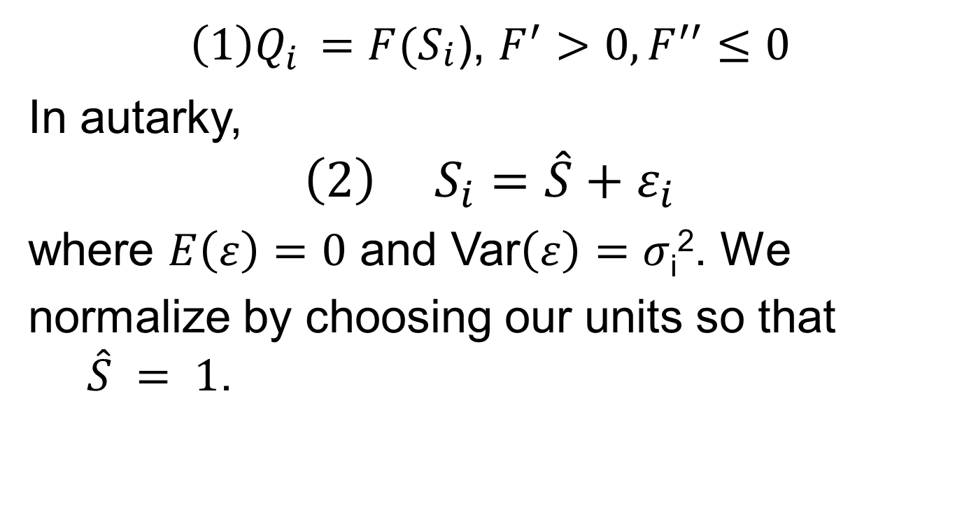
A simple example
$\left(1\right)Q_{i }=F(S_{\begin{aligned}i \\ \end{aligned}}$), $F^{′}>0, F^{′′}≤0$
In autarky,
$${\left(2\right) S}_{i}=\hat{S}+ε_{i}$$
where $E\left(ε\right)=0$ and Var$\left(ε\right)=σ$_{i}². We
normalize by choosing our units so that $\hat{S} = 1$.

Slide 11
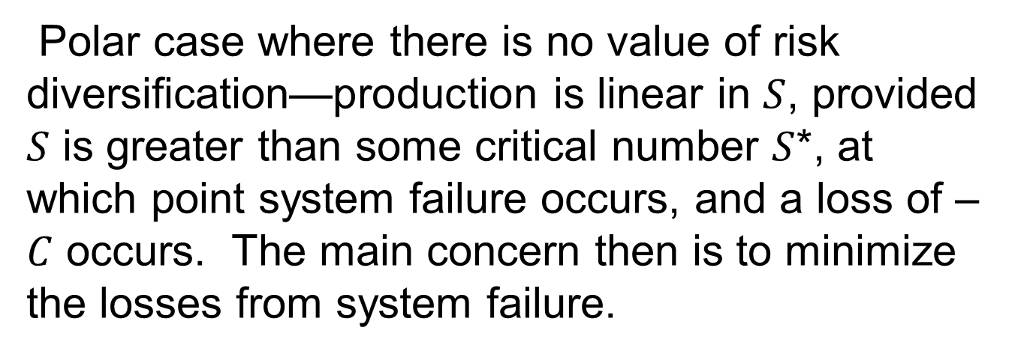
Simple example (cont.)
Polar case where there is no value of risk diversification—production is linear in $S$, provided $S$ is greater than some critical number $S$*, at which point system failure occurs, and a loss of –$C$ occurs. The main concern then is to minimize the losses from system failure.

Slide 12
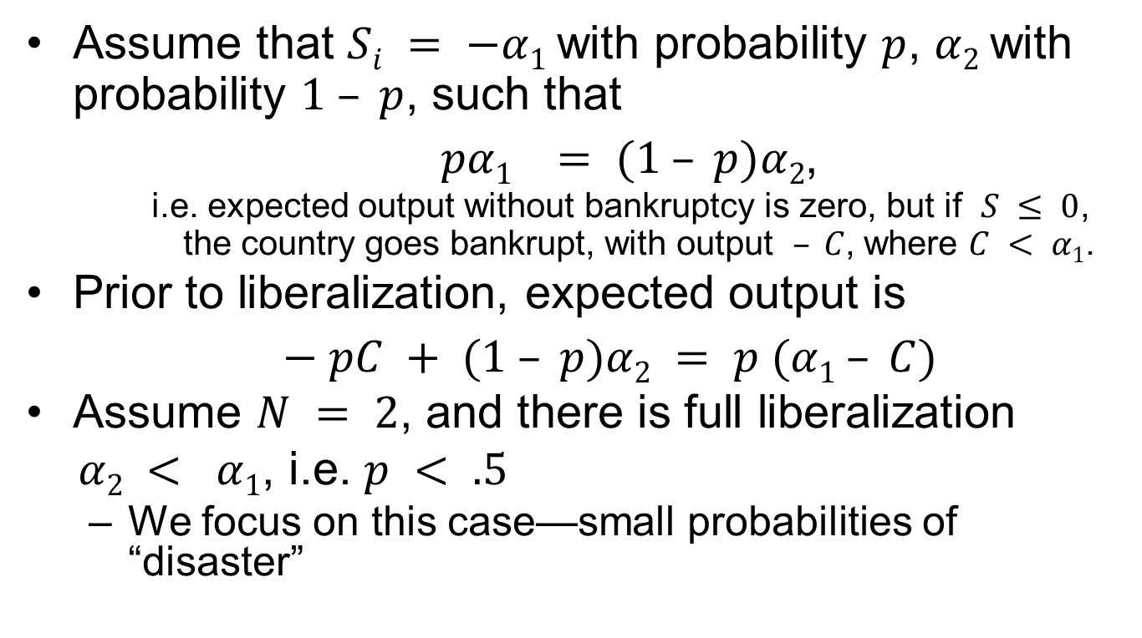
Simple example (cont.)
Assume that $Si = −α1$with probability $p$, $α2$with probability $1 – p$, such that
$pα1 = (1 – p)α2$,
    i.e. expected output without bankruptcy is zero, but if $S ≤ 0$, the country goes bankrupt, with output $– C$, where $C < α1$.
Prior to liberalization, expected output is
$− pC + (1 – p)α2 = p (α1 – C)$
Assume $N = 2$, and there is full liberalization
$α2 < α1$, i.e. $p < .5$
  We focus on this case—small probabilities of “disaster”

Slide 13
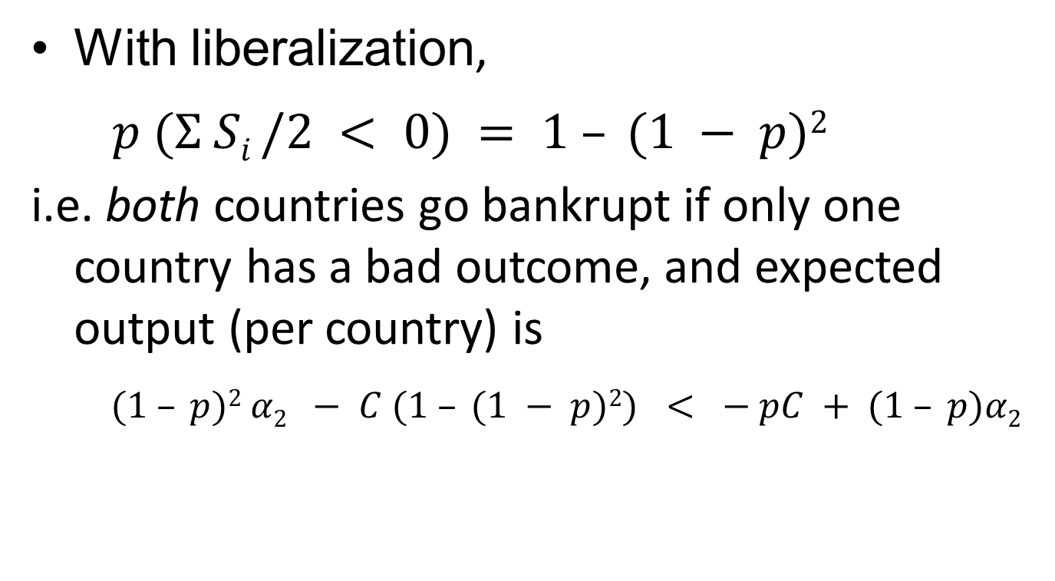
Liberalization is unambiguously welfare decreasing
With liberalization,
$p (Σ Si /2 < 0) = 1 – (1 − p)2$
i.e. both countries go bankrupt if only one country has a bad outcome, and expected output (per country) is
$(1 – p)2 α2 − C (1 – (1 − p)2) < − pC + (1 – p)α2$

Slide 14
Basic insight: even with mean preserving reductions in risk associated with risk pooling, the probability of any particular country falling below the bankruptcy threshold may increase with economic integration

Slide 15
Some General Results
Full integration never pays if there are enough countries
Optimal sized clubs
Restrictions on capital flows (circuit breakers) are desirable

Slide 16
Formally, two effects:
  Trend reinforcement—negative shocks move us down further (equity depletion)
    Modeling using stochastic differential equations, with probability that at any given time an agent goes bankrupt modeled as problem in first passage time
  With trend reinforcement, there is an optimal degree of diversification
    Battiston, Stefano, Domenico Delli Gatti, Mauro Gallegati, Bruce Greenwald, and Joseph E. Stiglitz, “Liaisons Dangereuses: Increasing Connectivity, Risk Sharing, and Systemic Risk,” paper presented to the Eastern Economic Association Meetings, February 27, 2009, New York, NBER Paper No.

Slide 17
Financial interlinkages
Bankruptcy cascades (Greenwald and Stiglitz, 2003; Gale and Allen, 2001)
  The bankruptcy of one firm affects the likelihood of the bankruptcy of those to whom it owes money, its suppliers and those who might depend upon it for supplies; and so actions affecting its likelihood of bankruptcy have adverse effects on others.
The “architecture” of the credit market can affect the risk that one bankruptcy leads to a sequence of others.
  If A lends to B, B lends to C and C lends to D, then a default in D can lead to a bankruptcy cascade.
  On the other hand, if lending all goes through a sufficiently well capitalized clearing house (a bank), then a default by one borrower is not as likely to lead to a cascade
  But a very large shock which leads to the bankruptcy of the “clearing house” can have severe systemic effects
Further externalities are generated as a result of information costs and imperfections.
  If unit i doesn’t fully know other units’ characteristics—including the relationships (contracts) of those with whom it engages in a relationship, including all the relationships with whom those are engaged, ad infinitum—it cannot know the risks of their honoring their contract.
  Explains some of adverse effects of non-transparent over the counter credit default swaps

Slide 18
Asymmetric Patterns
Our canonical model also assumed symmetric relationships in which all ties/contracts were identical.
In the presence of convexities, such symmetric arrangements often characterize optimal designs.
But that is not so in the presence of non-convexities, and there are many alternative architectures.
  For instance, a set of countries can be tightly linked (a “common financial market”) to each other, but the links among financial markets may be looser. The former is designed to exploit the advantages of risk diversification, the latter to prevent the dangers of contagion.
  Circuit breakers might be absent in the former but play a large role in the relations among the “common markets.”
Different architectures may lead to greater ability to absorb small shocks but less resilience to large shocks

Slide 19
Reducing the set of admissible relationships and behaviors can have benefits
  Reducing the scope for these uncertainties,
  Reducing the potential for information asymmetries,
  Reducing the burden on information gathering.
In large non-linear systems with complex interactions, even small perturbations can have large consequences
  Understanding these interactions major research agenda
Broader research agenda: Design of optimal networks, circuit breakers: optimal degree and form of financial integration
Beginning of large literature

Slide 20
References
Allen, Franklin and Douglas Gale, “Financial Contagion,” Journal of Political Economy, 108(1), 2000, pp. 1-33.
Battiston, Stefano, Domenico Delli Gatti, Mauro Gallegati, Bruce Greenwald, and Joseph E. Stiglitz, “Liaisons Dangereuses: Increasing Connectivity, Risk Sharing, and Systemic Risk,” paper presented to the Eastern Economic Association Meetings, February 27, 2009, New York.
Delli Gatti, Domenico, Mauro Gallegati, Bruce Greenwald, Alberto Russo, and Joseph E. Stiglitz, “Business fluctuations in a credit-network economy” Physica A, 370 (2006), pp. 68-74.
Delli Gatti, Domenico, Mauro Gallegati, Bruce Greenwald, Alberto Russo, and Joseph E. Stiglitz, 2006, “Business Fluctuations in a Credit-Network Economy,” Physica A, 370, pp. 68-74.
—— , —— , —— , ——, and ——, 2009, “Business Fluctuations and Bankruptcy Avalanches in an Evolving Network,” Journal of Economic Interaction and Coordination, 4(2), November, pp. 195-212.
De Masi, Giulia, Yoshi Fujiwara, Mauro Gallegati, Bruce Greenwald, and Joseph E. Stiglitz, forthcoming, "An Analysis of the Japanese Credit Network," Evolutionary and Institutional Economics Review.
Gai, Prasanna and Sujit Kapadia, 2010a, “Contagion in Financial Networks,” Proceedings of the Royal Society A, 466(2120), pp. 2401-2423.
—— and ——, 2010b, “Liquidity hoarding, network externalities, and interbank market collapse,” mimeo, Bank of England.
Gallegati, Mauro, Bruce Greenwald, Matteo G. Richiardi, Joseph E. Stiglitz, “The Asymmetric Effect of Diffusion Processes: Risk Sharing and Contagion,” Global Economy Journal 8(3), 2008

Slide 21
Greenwald, Bruce and J. E. Stiglitz, Towards a New Paradigm of Monetary Economics, Cambridge: Cambridge University Press, 2003
Jeanne, Olivier and Anton Korinek, 2010, “Excessive Volatility in Capital Flows: A Pigouvian Taxation Approach,” American Economic Review, 100(2), pp. 403–407.
Haldane, Andrew G., 2009, “Rethinking the Financial Network,” address to the Financial Students Association, Amsterdam, April, available at http://www.bankofengland.co.uk/publications/speeches/2009/speech386.pdf (accessed September 22, 2010).
Haldane, Andrew G. and Robert M. May, 2010, “Systemic risk in banking ecosystems,” University of Oxford mimeo.
Korinek, Anton, 2010a, “Regulating Capital Flows to Emerging Markets: An Externality View,” working paper, University of Maryland.
——, 2010b, “Hot Money and Serial Financial Crises,” working paper, University of Maryland, presented at the 11th Jacques Polak Annual Research Conference, November 4-5.
——, 2011, “Systemic Risk-Taking: Amplification Effects, Externalities, and Regulatory Responses,” working paper, University of Maryland.

Slide 22
Structural Transformation
Great depression was structural transformation from agricultural to manufacturing—this is a structural transformation from manufacturing to services
  Productivity growth well in excess of growth in demand
  Implying decrease in demand
  If labor gets “trapped” in declining sector, then income will decline

Slide 23
Technical change always can induce large distributive consequences
  Standard models ignore these
  With perfect markets, winners can compensate losers — but they seldom do
  With imperfect markets, decrease in welfare of those in “trapped sector” has spill over effects on others
  And especially if there are efficiency wage effects, there can be adverse macro-economic consequences

Slide 24
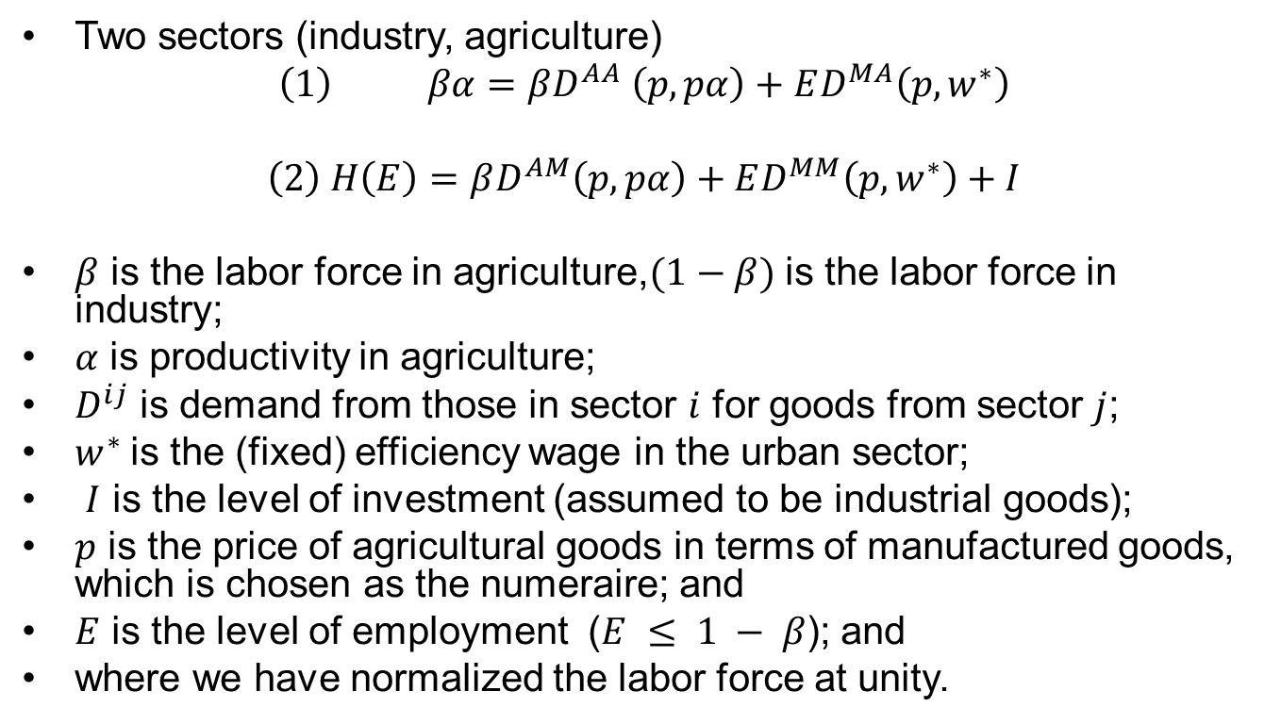
Basic Model
Two sectors (industry, agriculture)
$$\left(1\right) βα=βD^{AA} \left(p, pα\right)+ED^{MA}\left(p,w^{∗}\right)$$
$$\left(2\right) H\left(E\right)=βD^{AM}\left(p,pα\right)+ED^{MM}\left(p,w^{∗}\right)+I$$
$β$ is the labor force in agriculture,$(1−β)$ is the labor force in industry;
$α$ is productivity in agriculture;
$D^{ij}$ is demand from those in sector $i$ for goods from sector $j$;
$w^{∗}$is the (fixed) efficiency wage in the urban sector;
$I$ is the level of investment (assumed to be industrial goods);
$p$ is the price of agricultural goods in terms of manufactured goods, which is chosen as the numeraire; and
$E$ is the level of employment ($E ≤ 1 − β$); and
where we have normalized the labor force at unity.

Slide 25
Basic Results
Theorem 1: If
1) the steady state is stable
2) the income elasticity of the demand for food by rural workers is small enough,
3) c^{A} (the marginal propensity to consume manufactures by agricultural households) is sufficiently greater than c^{M} (the comparable marginal propensity to consume of manufacturing households)
then an increase in agricultural productivity unambiguously yields a reduction in the relative price p and in employment in manufacturing.

Slide 26
Results
The result of mobility-constrained agricultural sector productivity growth is an extended economy-wide slump.
Theorem 2: Under the stability condition, an increase in government expenditure increases urban employment and raises agricultural prices and incomes
Theorem 3: Under the stability condition an decrease in urban real product wages increases urban unemployment and lowers agricultural prices and incomes

Slide 27
Note irrelevance of standard model
Since such structural transformations occur very seldom, rational expectation models are not of much help
Since the central issue is structural, aggregate model with single sector not of much help
Since among major effects are those arising from redistribution, a representative agent model is not of much help
Since central issue entails frictions in mobility, assuming perfect markets is not of much help
Problems exacerbated by efficiency wage effects

Slide 28
Policy Implications
There should be structural policies to facilitate the movement of labor that is "trapped" in a dying sector
Even though structural policies are part of the solution, traditional Keynesian policies play a role
  Contrast to those who are now claiming that most of the remaining unemployment is structural – there is a new "normal" to which we must now accommodate ourselves – and therefore policies designed to stimulate the economy may not only be useless, they may be counterproductive.
Such policies were at the center of recovery from Great Depression

Slide 29
Reference
Domenico Delli Gatti; Mauro Gallegati; Bruce C. Greenwald; Alberto Russo; Joseph E. Stiglitz, “Sectoral Imbalances and Long Run Crises,” presented to IEA meeting, Beijing, July, 2011.

