Slide 1
Restoring Growth and Stability in a World of Crisis and Contagion:
Lessons from Economic Theory and History
Joseph E. Stiglitz
Prague
October 2011

Slide 2
Outline
Diagnosis
Prescriptions
Role and theory of contagion
Some general comments on the failure of modern macroeconomics
Concluding remarks

Slide 3
I. Diagnosis
Before the crisis, the US (and to a large extent the global) economy was “sick,” supported by a real estate bubble, that led to a consumption bubble
  Bottom 80% of Americans were consuming roughly 110% of their income
  Not sustainable

Slide 4
Financial and Real Crisis
While bubble “hid” underlying problems, it left in its aftermath additional problems
  Excess capacity in real estate
  Excess leverage
Major mistake of Administration was to think that fixing the banking system would “suffice”
  But they didn’t succeed in restoring lending
But even deleveraging won’t suffice to restore economy
  Won’t (and shouldn’t) return to world with consumption 110% of income

Slide 5
Underlying Problems
Structural transformation
Inequality
High oil prices
Globalization
Build up of global reserves

Slide 6
1. STRUCTURAL TRANSFORMATION
Great Depression was structural transformation from agricultural to manufacturing—this is a structural transformation from manufacturing to services
  Productivity growth well in excess of global growth in demand
  Implying decrease in demand for labor in manufacturing globally
  If labor gets “trapped” in declining sector, then income will decline

Slide 7
Technical change can always induce large distributive consequences
  Standard models ignore these
  With perfect markets, winners can compensate losers — but they seldom do
    With free mobility all workers can be better off
  With imperfect markets, those in rural sector worse off
    decrease in welfare of those in “trapped sector” has spillover effects on others
  And especially if there are efficiency wage effects, there can be adverse macroeconomic consequences

Slide 8
Basic Model
Two sectors (industry, agriculture)
(1) βα = βD^{AA} (p, pα) + E D^{MA} (p , w* )
(2) H(E) = βD^{AM} (p, pα) + E D^{MM} (p , w* ) +I
β is the labor force in agriculture, (1 - β) is the labor force in industry,
α is productivity in agriculture,
D^{ij} is demand from those in sector i for goods from sector j
w* is the (fixed) efficiency wage in the urban sector,
I is the level of investment (assumed to be industrial goods),
p is the price of agricultural goods in terms of manufactured goods, which is chosen as the numeraire, and
E is the level of employment (E ≤ 1 - β);
and where we have normalized the labor force at unity.

Slide 9
Results
Normally (under stability condition, other plausible conditions) with immobile labor
an increase in agricultural productivity unambiguously yields a reduction in the relative price of agriculture and in employment in manufacturing.
The result of mobility-constrained agricultural sector productivity growth is an extended economy-wide slump

Slide 10
Great Depression
From 1929 to 1932, US agriculture income fell more than 50%
While there had been considerable mobility out of agriculture in the 1920s (from 30% to 25% of population), in the 1930s almost no outmigration
  Labor was trapped
  Could not afford to move
  High unemployment meant returns to moving low

Slide 11
Financial and Real Causes of Downturn
Banking crisis was a result of the economic downturn, not a cause
But financial crisis can help perpetuate downturn

Slide 12
Government Expenditures
Under the stability condition, an increase in government expenditure increases urban employment and raises agricultural prices and incomes
Even though problem is structural, Keynesian policies work
Even more effective if spending is directed at underlying structural problem

Slide 13
Emerging from the Great Depression
New Deal was not big enough to offset negative effects of declining farm income
And much of Federal spending offset by cutbacks at state and local level
Analogous to current situation, where government employment is now lower by 700,00 than it was before crisis
  Local government alone has lost 550,000 since the peak of employment in September 2008

Slide 14
War
WWII was a massive Keynesian stimulus
Moved people from rural to urban sector
Provided them with training
Especially in conjunction with GI bill
It was thus an “industrial policy” as well as a Keynesian policy
Forced savings during War provided stimulus to buy goods after War
  In contrast to the legacy of debt now

Slide 15
Wages
In model, under normal condition, lowering urban wages lowers agricultural prices and urban employment
High (rigid) wages are not the problem
Lowering wages would lower aggregate demand—worsen the problem
In this crisis, the US—country with most flexible labor market—has had poor job performance, worse than many others

Slide 16
An Aside on Irrelevance of Standard Macro-models
Since such structural transformations occur very seldom, rational expectation models are not of much help
Since the central issue is structural, aggregate model with single sector not of much help
Since among major effects are those arising from redistribution, a representative agent model is not of much help
Since central issue entails frictions in mobility, assuming perfect markets is not of much help
Problems exacerbated by efficiency wage effects

Slide 17
Reference
Domenico Delli Gatti; Mauro Gallegati; Bruce C. Greenwald; Alberto Russo; Joseph E. Stiglitz, “Sectoral Imbalances and Long Run Crises,” presented to IEA meeting, Beijing, July, 2011.

Slide 18
2. INEQUALITY
Redistribution from those who would spend all of their income to those that don’t lowers aggregate demand
Large increases in inequality in most countries of the world
America said “spend as if your income was going up,” that is—borrow
Problem exacerbated—downturn leading to lower wages and incomes

Slide 19
3. RISING OIL PRICES
Meant US consumers were spending more of their income abroad
In effect, a redistribution from oil consuming countries to oil rich countries

Slide 20
4. GLOBALIZATION
Global competition for limited number of manufacturing jobs
Shifting comparative advantage compounded problems for US
One of factors contributing to growing inequality

Slide 21
5. GLOBAL RESERVES
Build up of reserves weakened global aggregate demand
Some of it based on precautionary savings—response to crisis exacerbating this problem too (countries with large reserves did better)
Some of reflecting high oil prices
Some of it part of export-led growth—most successful growth strategy

Slide 22
References
UN Commission
J. E. Stiglitz, Freefall

Slide 23
II. Remedies
Increase aggregate demand
Addressing underlying issues
Facilitate the structural transformation
  Adapting to changing comparative advantage
  Helping economy move into services
Reduce inequality
Reduce dependence on oil
Reduce need for global reserves
Finish the task of fixing the financial system and underlying real estate problem

Slide 24
Finishing the Task of Fixing the Financial System
Redirecting financial system to its core mission—lending (carrots and sticks)
  Restricting speculative activities, proprietary trading (“ringfencing”)
Helping community and regional banks
  TARP was directed at helping the big banks
Reregulating the banks
  Restricting excess leverage (Basel III doesn’t go far enough, failed to understand insights of Modigliani and Miller)
  Doing something about the too-big-to-fail financial institutions
  Transparency (e.g. OTC derivatives)
  Prohibiting predatory lending
  Stopping anti-competitive practices

Slide 25
Mortgages
Real estate markets continues to fall
Foreclosures continue apace
  Administration efforts inadequate
  More than 20% of mortgages underwater
What is needed: Homeowners’ Chapter 11
Alternatively: carrots and sticks to get banks to restructure
  Changing in accounting rules
  Tax incentives

Slide 26
Increasing Aggregate Demand
Government spending in a world with fiscal deficits
  High return investments lower debt/GDP in medium term
  Well designed tax and expenditure programs can yield balanced budget multiplier of 2-3.
  Shifting composition of taxes and expenditures can increase GDP
Cutbacks in spending can impede transition
  Especially since two of critical services (education and health) are typically government financed

Slide 27
Design of Stimulus
High multipliers
High job multipliers
Sensitive to sectoral/skill mix of unemployed
Money gets quickly into system
  Assistance to states and localities, which otherwise would have to fire teachers
Addressing long term problems
  Facilitating restructuring
  Reducing inequality
  Investments (infrastructure, technology, education)
  Protecting the environment
Sensitive to long term nature of problem
  Short term palliatives won’t work
  Scope for longer term investment strategy

Slide 28
Objections
With interest rate fixed at low levels, deficits won’t crowd out private investment
Public investment crowds in private investment
Ricardian equivalence doesn’t hold
Well-designed investments improve future fiscal position, should lead to more consumption today
Savings today translates into spending tomorrow; if future periods demand constrained, increases income in future; expectation of that leads to more consumption today: with rational expectations, multipliers are larger

Slide 29
Promoting Investment
In US biggest needs are in public sector
What is holding back investment?
  Excess capacity in many sectors
    Lower interest rates and supply side policies won’t help
  Macro-uncertainty
    Government could issue “macro-Arrow-Debreu” securities
    Speeches about confidence, green shoots, won’t work
      In long run, counterproductive
  NOT too high taxes
    Lowering corporate tax rate will have no significant effect, except on cash constrained firms
      To extent that investment is debt financed, cost of capital will increase

Slide 30
A Green Growth Strategy
Raising carbon prices will induce significant amounts of new investment
Uncertainty about carbon price may be impeding investment
  Government could provide carbon price guarantees, paying off if carbon price is lower than critical level in future years
Reducing dependence on oil will also have benefits for global aggregate demand
A New Innovation model—focusing on saving the environment, rather than saving labor
  Especially important in a world with high unemployment

Slide 31
Global Strategy
In world of globalization, what matters is global aggregate demand
Reform of global reserve system key
Improving recycling of savings from reserve countries to where investment is badly needed
  Bernanke was wrong—the problem was not a savings glut
  G-20 strategy of encouraging consumption is misguided
    Planet will not survive if everyone aspires to US patterns of consumption
  Enormous needs for investments in developing countries and to retrofit global economy for global warming
  Mistake was that financial markets didn’t allocate capital well
  Part of the problem is that there needs to be better risk mitigation facilities

Slide 32
Limited Scope for Monetary Policy
Short-term interest rates can’t get any lower
QE III effect on LT interest rates limited
Hard to show any quantitatively significant effect of change in interest rates on investment or consumption,
  especially in periods of excess capacity, excess leverage
  Especially when “credit channel” is blocked, because of failure to fix banks
  QE I and II didn’t work—why expect QE III to do so?

Slide 33
Temporary measures likely to limit asset price effects, and even smaller consumption effects
In a globalized capital market, money flows to where return is highest
  In emerging markets, where it’s not needed
  Not in US, where it’s needed
Most effective channel may be through competitive devaluation
  But that only works if others don’t respond
  They are responding, with exchange rate interventions, capital controls, etc
  Leading to fragmentation of global capital market

Slide 34
Low interest rates may even be ensuring that we have a jobless recovery
  Evidence that this (and other recent recessions) are different
  In vintage capital model (putty-clay), low long term interest rates induce firms to use capital intensive technology—making labor redundant

Slide 35
III. Interconnectivity and Contagion:
How the Crisis Spread Around the World
Theoretical question: Does Interconnectivity lead to more or less systemic stability?
Standard answer: spreading of risk, with concavity, leads to better outcomes

Slide 36
But economic systems are rife with non-convexities—e.g. bankruptcy
Interlinked systems are more prone to system wide failures, with huge costs
  privately profitable transactions may not by socially desirable (Greenwald-Stiglitz, "Externalities in Economies with Imperfect Information and Incomplete Markets," The Quarterly Journal of Economics, 101(2), pp. 229-64. 1986)
  May lead to systemic risk
This crisis illustrates the risk

Slide 37
Incoherence in Standard
Macro-frameworks
Argue for benefits of diversification (capital market liberalization) before crisis
Worry about contagion (worsened by excessive integration) after crisis
Optimal system design balances benefits and costs
  “Contagion, Liberalization, and the Optimal Structure of Globalization,” Journal of Globalization and Development, 1(2),
  “Risk and Global Economic Architecture: Why Full Financial Integration May be Undesirable,” American Economic Review, 100(2), May 2010, pp. 388-392

Slide 38
An Analogous Problem
With an integrated electric grid the excess capacity required to prevent a blackout can be reduced
  alternatively, for any given capacity, the probability of a blackout can be reduced.
But a failure in one part of the system can lead to system-wide failure
  in the absence of integration, the failure would have been geographically constrained
Well-designed networks have circuit breakers, to prevent the “contagion” of the failure of one part of the system to others.

Slide 39
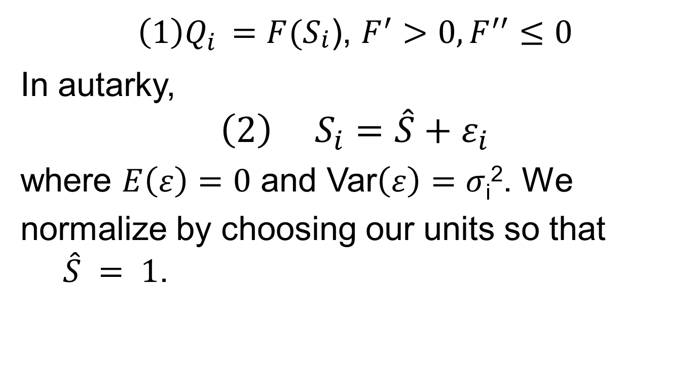
A Simple Example

Slide 40
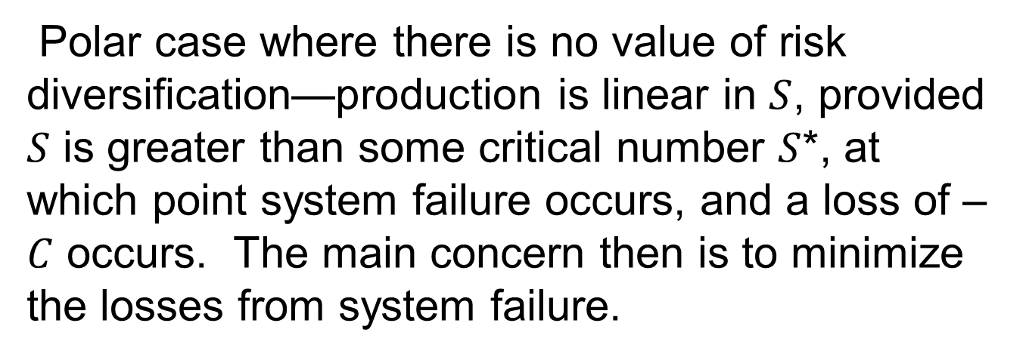
Simple Example (cont.)

Slide 41
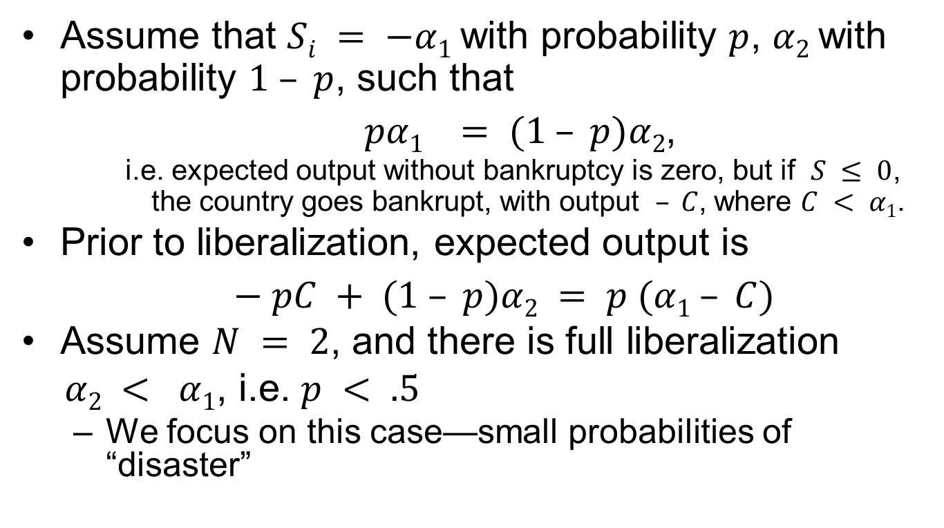
Simple Example (cont.)

Slide 42
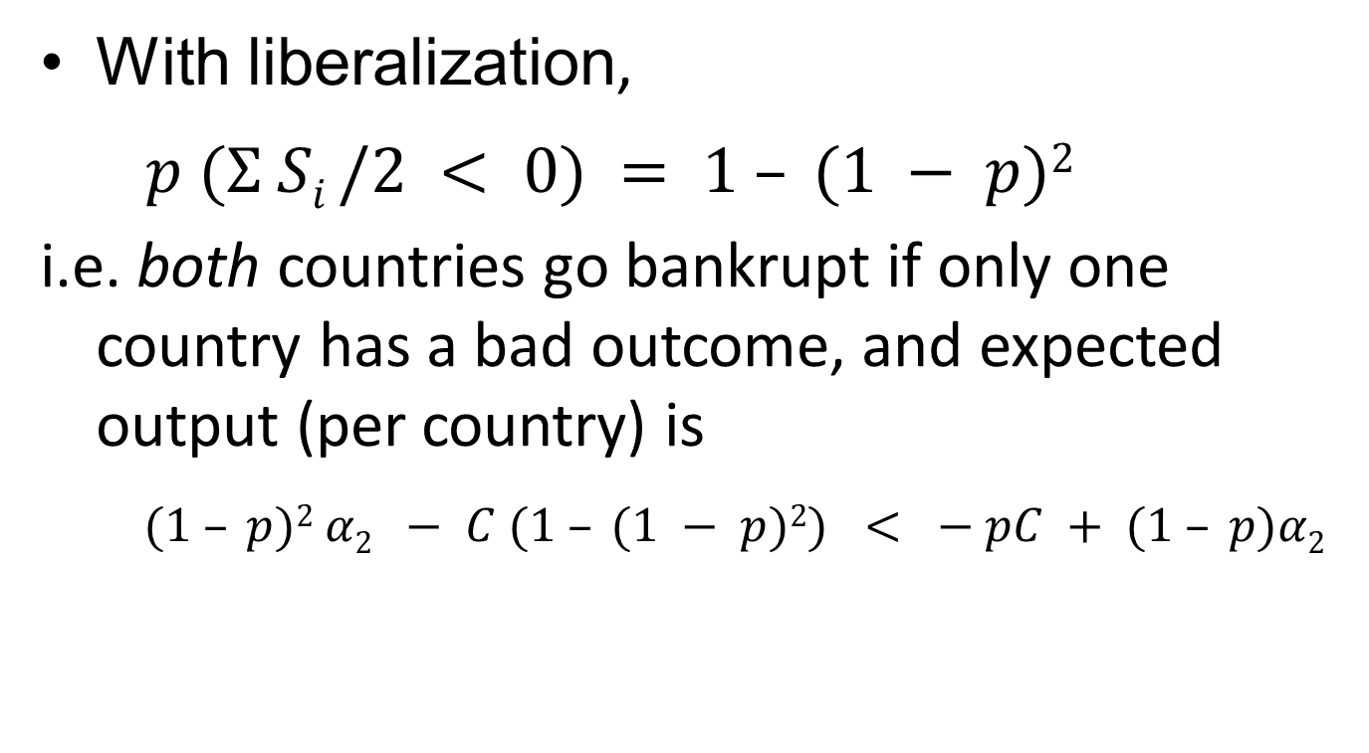
Liberalization is Unambiguously Welfare Decreasing

Slide 43
Basic insight: even with mean preserving reductions in risk associated with risk pooling, the probability of any particular country falling below the bankruptcy threshold may increase with economic integration

Slide 44
Some General Results
Full integration never pays if there are enough countries
Optimal sized clubs
Restrictions on capital flows (circuit breakers) are desirable

Slide 45
Formally, two effects:
  Trend reinforcement—negative shocks move us down further (equity depletion)
    Modeling using stochastic differential equations, with probability that at any given time an agent goes bankrupt modeled as problem in first passage time
  With trend reinforcement, there is an optimal degree of diversification
    Battiston, Stefano, Domenico Delli Gatti, Mauro Gallegati, Bruce Greenwald, and Joseph E. Stiglitz, “Liaisons Dangereuses: Increasing Connectivity, Risk Sharing, and Systemic Risk,” paper presented to the Eastern Economic Association Meetings, February 27, 2009, New York, NBER Paper No.

Slide 46
Financial interlinkages
Bankruptcy cascades (Greenwald and Stiglitz, 2003; Gale and Allen, 2001)
  The bankruptcy of one firm affects the likelihood of the bankruptcy of those to whom it owes money, its suppliers and those who might depend upon it for supplies; and so actions affecting its likelihood of bankruptcy have adverse effects on others.
The “architecture” of the credit market can affect the risk that one bankruptcy leads to a sequence of others.
  If A lends to B, B lends to C and C lends to D, then a default in D can lead to a bankruptcy cascade.
  On the other hand, if lending all goes through a sufficiently well capitalized clearing house (a bank), then a default by one borrower is not as likely to lead to a cascade
  But a very large shock which leads to the bankruptcy of the “clearing house” can have severe systemic effects
Further externalities are generated as a result of information costs and imperfections.
  If unit i doesn’t fully know other units’ characteristics—including the relationships (contracts) of those with whom it engages in a relationship, including all the relationships with whom those are engaged, ad infinitum—it cannot know the risks of their honoring their contract.
  Explains some of adverse effects of non-transparent over the counter credit default swaps

Slide 47
Asymmetric Patterns
Our canonical model also assumed symmetric relationships in which all ties/contracts were identical.
In the presence of convexities, such symmetric arrangements often characterize optimal designs.
But that is not so in the presence of non-convexities, and there are many alternative architectures.
  For instance, a set of countries can be tightly linked (a “common financial market”) to each other, but the links among financial markets may be looser. The former is designed to exploit the advantages of risk diversification, the latter to prevent the dangers of contagion.
  Circuit breakers might be absent in the former but play a large role in the relations among the “common markets.”
Different architectures may lead to greater ability to absorb small shocks but less resilience to large shocks

Slide 48
Reducing the set of admissible relationships and behaviors can have benefits
  Reducing the scope for these uncertainties,
  Reducing the potential for information asymmetries,
  Reducing the burden on information gathering.
In large non-linear systems with complex interactions, even small perturbations can have large consequences
  Understanding these interactions major research agenda
Broader research agenda: Design of optimal networks, circuit breakers: optimal degree and form of financial integration
Beginning of large literature

Slide 49
references
Greenwald, Bruce and J. E. Stiglitz, Towards a New Paradigm of Monetary Economics, Cambridge: Cambridge University Press, 2003
Jeanne, Olivier and Anton Korinek, 2010, “Excessive Volatility in Capital Flows: A Pigouvian Taxation Approach,” American Economic Review, 100(2), pp. 403–407.
Haldane, Andrew G., 2009, “Rethinking the Financial Network,” address to the Financial Students Association, Amsterdam, April, available at http://www.bankofengland.co.uk/publications/speeches/2009/speech386.pdf (accessed September 22, 2010).
Haldane, Andrew G. and Robert M. May, 2010, “Systemic risk in banking ecosystems,” University of Oxford mimeo.
Korinek, Anton, 2010a, “Regulating Capital Flows to Emerging Markets: An Externality View,” working paper, University of Maryland.
——, 2010b, “Hot Money and Serial Financial Crises,” working paper, University of Maryland, presented at the 11th Jacques Polak Annual Research Conference, November 4-5.
——, 2011, “Systemic Risk-Taking: Amplification Effects, Externalities, and Regulatory Responses,” working paper, University of Maryland.

Slide 50
IV. Failures of Modern Macroeconomics
Didn’t predict the financial crisis
  Standard models assert that bubbles can’t happen
  Standard models assert that shocks are exogenous
    Key “disturbance” to the economy was endogenous
  Policy frameworks suggested that (a) keeping inflation low was necessary, and almost sufficient, for stability and growth; (b) government didn’t have instruments to prevent bubbles; (c) cheaper to clean up mess after bubble broke
EACH OF THESE BELIEFS WAS WRONG

Slide 51
Even after bubble burst, economists claimed effects “contained”
  because of diversification
  because markets have good “buffers”

Slide 52
Responses to crises (based on advice from economists) have clearly been inadequate
  High unemployment 4 years after beginning of recession
  Standard models didn’t focus on credit—and therefore didn’t have much to say on repairing credit system
    But theory of banking provided micro-foundations (including incentives of banks and bankers)
    Policies ignored lessons of this literature (Greenwald-Stiglitz, 2003)
  Even less to say on inherent deficiencies in securitization
    Questionable improvements in risk diversification
    Unambiguous attenuation of incentives (selection, monitoring, enforcement)
    Some market participants took advantage of information asymmetries
    Remarkable testimony to inefficiency, irrationality of markets that market participants did not recognize these (and other) problems
      Including risk of increased leverage
      Market didn’t seem to learn lesson of Modigliani-Miller

Slide 53
Moreover, countries that have had highest persistent unemployment include those with allegedly most flexible labor markets (e.g. US), in contradiction to standard theory
  But consistent with earlier studies of volatility
    Easterly, W., R. Islam, and Joseph E. Stiglitz, 2001a, “Shaken and Stirred: Explaining Growth Volatility,” in Annual Bank Conference on Development Economics 2000, Washington: World Bank, pp. 191-212.
    —— , ——, and —— , 2001b, “Shaken and Stirred: Volatility and Macroeconomic Paradigms for Rich and Poor Countries,”, in Advances in Macroeconomic Theory, Jacques Drèze (ed.), IEA Conference Volume, 133, Palgrave, 2001, pp. 353-372

Slide 54
There were large losses associated with misallocation of capital before the bubble broke. It is easy to construct models of bubbles. But most of the losses occur after the bubble breaks, in the persistent gap between actual and potential output
  Standard theory predicts a relatively quick recovery, as the economy adjusts to new “reality”
    New equilibrium associated with new state variables (treating expectations as a state variable)
    And sometimes that is the case (V-shaped recovery)
  But sometimes the recovery is very slow
    Persistence of effects of shocks
    Explained by slow recovery of balance sheets (Greenwald-Stiglitz, 1993, 2003)
    But current persistence is greater than can be explained by these models

Slide 55
V. Concluding Remarks
Current downturn likely to be long
  And if something isn’t done soon about jobs situation, hysteresis effects will set in, making return to full employment all the more difficult
Slump is more than a financial crisis
  Though the financial crisis will make the return to full employment all the more difficult
We have to look at the underlying real problems and address them
  Unless we do so, we won’t succeed in recovering
  And what we do may even be counterproductive

Slide 56
The crisis is not only a crisis in the economy, but also should be a crisis in economics
  Standard models contributed to policies that led to the crisis
  Have provided us little guidance on how to respond
  But the building blocks with which alternative theories can be constructed are already available
  J.E. Stiglitz, 2011, “Rethinking Macroeconomics: What Failed and How to Repair It,” Journal of the European Economic Association, 9(4), pp. 591-645.

