Slide 1
Investing in a Net-Zero Future
Columbia Global Centers | Mumbai
January 12, 2023
Bruce Usher
Professor of Practice
Elizabeth B. Strickler '86 and Mark T. Gallogly '86 Faculty Director
The Tamer Center for Social Enterprise
Columbia Business School
Notes:
Begin w a Q. What has been the greatest influence on biz since you graduated biz school? If any of you graduated biz school when I did, exactly 3 decades ago, that Q is easy to A: technology. Tech has upended every industry, from retail to automobiles, from entertainment to. And the impact on tech on business has, of course, implications for inv’s, risks and returns. Next Q for you, looking ahead next 3 decades…
Obj: explain cc trends affecting inv for next 3-5 decades, inv opportunities arising from those trends, the strategies employed by inv’s, and the impact of inv to address greatest Q of our children’s generation – will they avoid catastrophic cc? Audacious set of obj’s

Slide 2
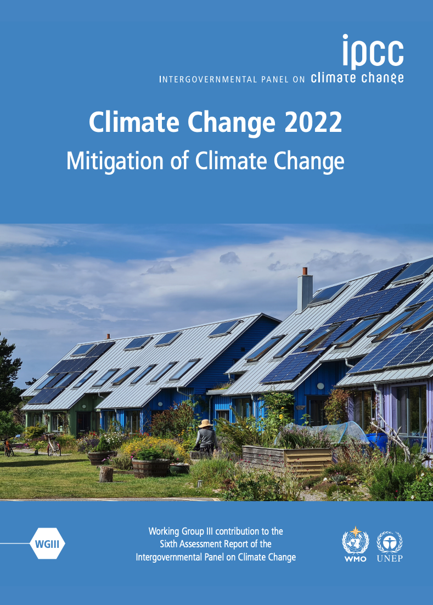
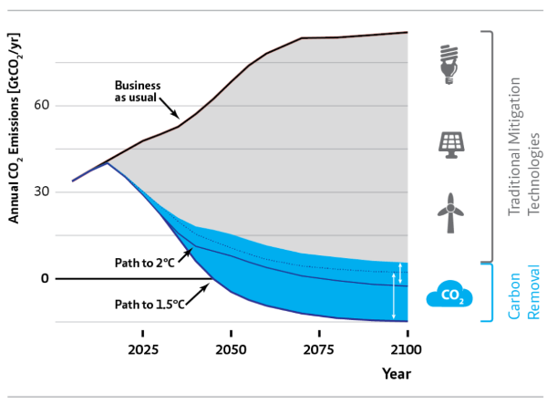

Slide 3
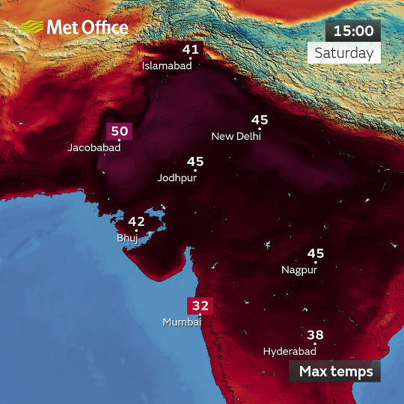
1. Manifestation of Physical Risks
Trends
"India could become one of the first places in the world to experience heat waves that break the human survivability limit.”
World Bank Report, 2022

Slide 4

Trends
2. Evolving Social Norms
“I want you to act as if our house is on fire, because it is.”
Greta Thunberg, Climate Activist

Slide 5
3. Government Action
Trends
“The Inflation Reduction Act invests $369 billion to take the most aggressive action ever — ever, ever, ever — in confronting the climate crisis.”
President Biden

Slide 6
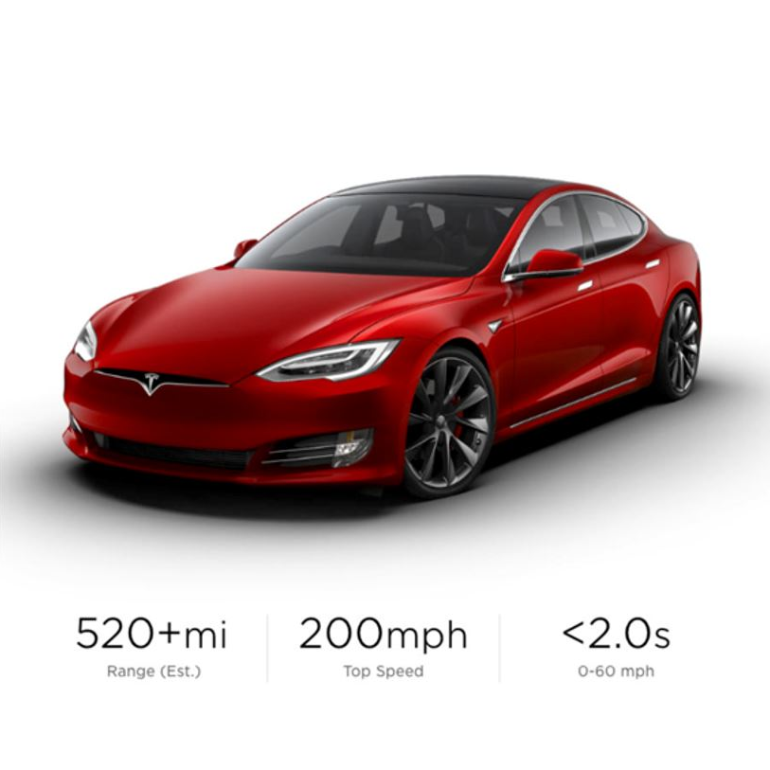
Trends
4. Innovation
Tesla’s all-electric Model S is “the best-performing car that Consumer Reports has ever tested.”

Slide 7
Trends
Investor Reaction
“In the near future – and sooner than most anticipate – there will be a significant reallocation of capital.”
Larry Fink, CEO, BlackRock

Slide 8
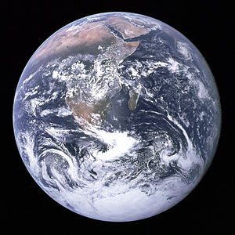
Climate Solutions

Slide 9
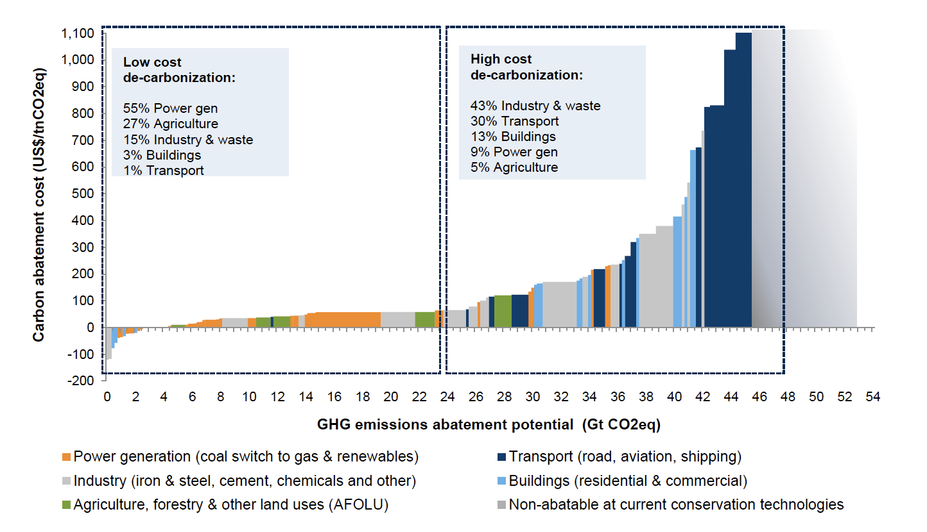
Climate Solutions
Carbon Abatement Cost Curve
Source: Goldman Sachs

Slide 10
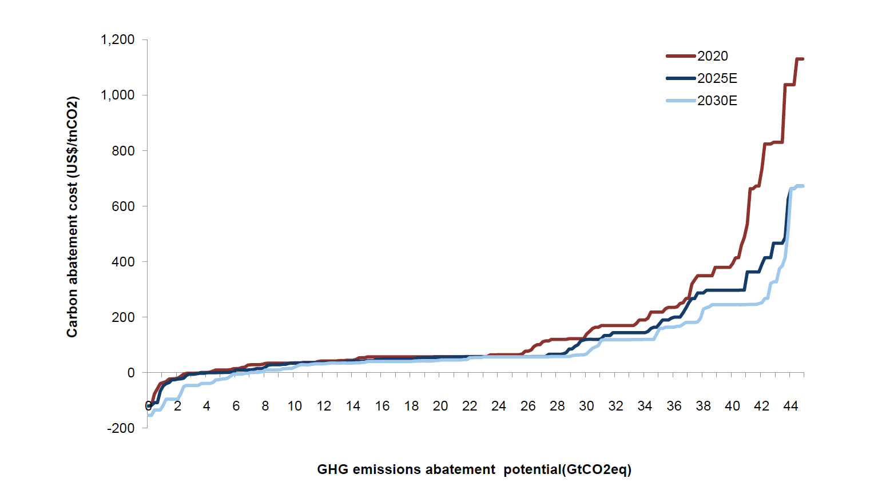
Climate Solutions
Carbon Abatement Cost Curve Projections
Source: Goldman Sachs

Slide 11
Investor Strategies

Slide 12
Investing in a Net-Zero Future
Discussion
Columbia Global Centers | Mumbai
January 12, 2023

