Slide 1
Navigating Your Student Loan Repayment
May 2024
Graduates
Notes:
Intro/welcome

Slide 2
Overview
Determining Your Loan Portfolio
  What You Borrowed and Where to Find it
Debt Management
  Repayment Plans, Strategies, Other Considerations
  COVID-19 – CARES Act
Next Steps
  What to Expect and When to Take Action
Q&A
Notes:
What we’re covering

Slide 3
Additional Resources
Graduation Matrix
Understanding Loan Types
Prodigy Finance Loan Program Details
Repayment Plan Summary Chart
Federal Repayment Plans (detailed)
Lender-Specific Websites
Repayment Calculators
Default, Delinquency
Look for these at the end of the presentation…
Notes:
Presentation will cover big picture, these additional resources provide greater details and examples
Will need to remove Quorum in future versions

Slide 4
Determining Your Loan Portfolio
The 2024 Graduate has a loan portfolio that may contain any or all of the following loan types:
Federal
Direct Unsub
Fixed rate
Consolidation
Fixed rate
Stafford (prior degree)
Variable
Direct Grad
PLUS
Fixed rate
Private
Fixed/Variable
Perkins
Fixed and serviced separately
Notes:
Note that Perkins is federal but very unlikely to be with your same fed servicer (held by the school, usually serviced by third party)
Fed loans from prior degrees and CBS same servicer

Slide 5
Determining Your Loan Portfolio
What types of education loans do you have? How many loans do you have?
  Federal Stafford/Direct Loans, Consolidation Loans, Graduate PLUS loans, private loans, prior loans from other degrees, etc.
Who is the lender or servicer for each of your student loans?
  Sometimes the lender is one entity but the servicer is completely different. Your federal loan servicer may be changing – be sure to keep your contact information up-to-date with your current servicer.
How much and when did you borrow each loan?
  This will help you determine the best repayment option and calculate any accrued interest
Notes:
Knowing your debt types helps you to plan and strategize
Most lenders don’t service the loans so knowing both is necessary
Timing of your loans will drive interest rate and accrual

Slide 6
Determining Your Loan Portfolio
SSOL
ssol.columbia.edu
Go to Financial Aid => Student Loan History
Federal Student Aid Information Center (FSAIC)
Central contact for federal student loans
Lender-Specific Websites
Private Lenders
Log in using borrower-specified username and password
Can provide servicer and contact information
Call 1-800-433-3243
Will show original principal balances borrowed while at Columbia (for all schools attended)
Notes:
Note that fed loan amounts on SSOL loan history will differ from amounts applied to account due to fees
Fed loan rates are estimated based on fall disbursement (post-July 1 rate for the AY), if you were J-term/dual borrowing in summer, confirm your rate with your servicer
SSOL private loan interest rate defaults to 10% so confirm your actual rates with your lender/servicer

Slide 7
Debt Management
Before you choose your Loan Repayment Terms, you need a plan.
Choose a repayment timeline to meet financial goals.
When it comes to determining a repayment strategy to fit your needs, remember that a “one size fits all” approach does not work.
  Don’t copy your friends: Different priorities = different goals = different needs
Be sure to consult with your loan servicer and use the tools at your disposal.
Repayment strategies are borrower-specific and tailored to meet the borrower’s financial goals, for example:
    Pay student loan debt quickly
    Pay higher rate debt first
    Save to buy a house, start a family
    Relocate, go into business, etc.
    Working in public sector
There are no prepayment penalties on student loans so please keep this in mind as your salary increases and as you consider your bonuses.
Notes:
Great to get ideas from friends but your plan should be tailored to you

Slide 8
Debt Management: CARES Act
The initial CARES Act (Coronavirus Aid, Relief, and Economic Security Act) and subsequent extensions include a number of provisions of interest to student loan borrowers.
  This provision was been in effect since March 13, 2020, and expired on August 30, 2023.
  This means your balance on loans such as Direct Unsubsidized and Direct PLUS (Grad PLUS) remained the same during this time.
  This provision applied to all borrowers with these loans.
Notes:
Slide needs revisions for future classes
Review how interest pause affected total debt at repayment

Slide 9
Federal Repayment Plans
Level (10 Years)
Graduated
(10 Years)
Extended
(up to 25 Years)
Income-Driven
Default plan for Direct Unsubsidized and Graduate PLUS
Same payment each month for 120 monthly payments
Lower initial payments that increase every few years
Graduated or Level
Must have total indebtedness in federal loans of at least $30,000
4 Plan Options: Saving on a Valuable Education (SAVE), Income Based Repayment (IBR), Pay As You Earn (PAYE), Income Contingent Repayment (ICR)
Notes:
Caution on income-driven – annual reapplication, amount could exceed 10yr plan if big income jump (AGI), not usually a good fit for CBS grads due to income levels, meet one-on-one if you are considering an IDR plan

Slide 10
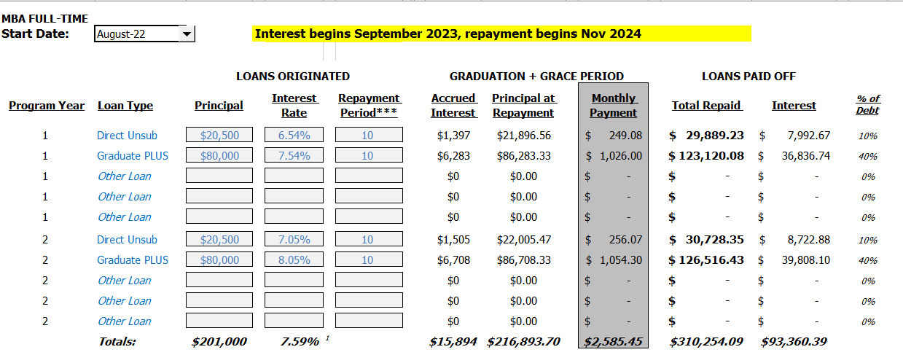
Example Repayment (Level 10 Years)*
*Amounts are estimated
Notes:
Comparison for demonstration only, go to the link and plug in your borrowing

Slide 11
Private Loan Repayment Considerations
Private loans may have a fixed or variable rate. You may review your promissory note/loan agreement to confirm your rate or you may reach out to your lender.
Accrued interest paid by borrower or capitalized at repayment
Generally, repayment period is 7-20 years
  Determined at the time of application, at repayment, or based on your total borrowed amount – check with your lender on your options
6-month grace period
Managing variable rate private loans
    Payment amounts can change monthly, quarterly, or annually, depending on the loan terms
    Harder to forecast
      Requires more careful budgeting
      Example below assumes a $36,500 original principal and 10-year repayment
Extending your Federal loan repayment out to 25 years can help with lowering monthly payments which can offer more funds to focus on repaying higher, variable rate private loans
Should I consider private loan refinancing to get a fixed interest rate?
Interest Rate | Monthly Payment Amount
3.25% | $369
5.25% | $413
7.25% | $461
9.25% | $512
Notes:
Your private loan repayment options may have been determined at borrowing, check with your lender/servicer
Fixed rate means you know the amount every month, variable rate requires a bit more planning but likely would change at most quarterly

Slide 12
No Cosigner Loans: Repayment Options
Prodigy – prodigyfinance.com
  Payment options include auto-debit from a U.S. bank account, wire transfer, FlyWire, or Wise
MPOWER – mpowerfinancing.com
  Payment options include electronic through your MPOWER account or international money transfer
Notes:
Mention greater detail on repayment for these lenders in additional resources
Quorum will need to be removed in future versions

Slide 13
Strategies for Repayment
Private Loan Refinancing
Several lenders have come to market with a refinance loan. This loan is a private loan and unrelated to the federal loan consolidation product.
Borrowers who need flexible repayment options, are considering careers in public service or non-profit, or who are not comfortable with the uncertainty of borrowing through a start-up should not consider this loan product.
This loan product is likely only beneficial to those who plan to repay their loans quickly, have no worries related to unemployment or economic hardship, or who will never need a repayment plan to coincide with their income levels.
Notes:
Note international students: MPOWER now has an option for international refi to explore but otherwise international student refi would require a cosigner
Timing matters, consider your grace period(s) for the loans, and employment status, but may refi after loans have disbursed or at graduation depending on lender
More akin to other consumer debt so your employment status and credit matter even more in terms of qualifying for great rate, some refi lenders require you to already be working
If you have high interest rates on your current loans, and plan to pay off the loans aggressively, and you have great employment this could make the total cost less

Slide 14
Strategies for Repayment
Private Loan Refinancing – Additional Considerations
If you are planning to apply for a mortgage, the ability to lower your required monthly payment by extending your repayment plan under the federal loan program may be beneficial
  Underwriters consider your monthly debt-to-income in determining how much you can afford in a mortgage
There is no ability to refinance back into the federal loan program – once you refi into a private loan you forfeit all of the benefits associated with the federal loan program for the loans you have refinanced
  Additional consideration should be given to the timing of refinancing given the current 0% interest rate on federal loans effective until August 31
Notes:
If you borrowed fed loans for the flexible and protective benefits – you lose them all in a refi
Re-evaluate the refi option later on down the road if your situation changes

Slide 15
Prepayment Consideration…
  Should I focus on prepayment?
  Do you have an established emergency fund?
Lowering your debt is great, but in times of uncertainty, consider where this falls in your list of financial priorities.
Most loans have deferment and forbearance options to forgo payments during periods of financial difficulties but chances are your rent or mortgage will still be due each month.
Housing > Lowering your Debt
Notes:
Once you pay that money to your loans you will never get it back…make sure you don’t need it before you prepay
Loans are only one part of your total financial picture

Slide 16
Deferment and Forbearance
What is deferment?
If you find that you are unable to meet your monthly payment obligations, contact your loan servicer right away. You may qualify for a deferment that will allow you to postpone making principal payments on your loan. The most common deferments granted are those for:
  In-school periods ------------granted without time limit
  Unemployment ------------applied for annually for up to 36 months maximum
  Economic hardship -------applied for annually for up to 36 months maximum
  Other deferment options may be available – contact your servicer
What is forbearance?
For borrowers with temporary financial issues who do not meet the requirements for deferment, you may suspend your payments under certain circumstances by requesting forbearance. You will be responsible for the interest that accrues on your loan. This interest is added to the amount you owe when you re-enter repayment and must be repaid when payments resume.
Forbearances are at the loan servicer’s discretion and many have a cap on how long a forbearance can last. Use this sparingly in case of an emergency down the road.
  You must apply for a deferment or forbearance when not in school – it is not automatic.
Notes:
You’ve had an automatic deferment while in school but any future pause on your payments will require action on your part

Slide 17
Strategies for Repayment
Consider paying down/off interest before it capitalizes
  Interest is capitalized on your federal Direct Unsubsidized loan and most private loans just before you enter repayment; the federal Graduate PLUS loan may capitalize just prior to graduation and again just before you enter repayment
  Up to $2,500 in interest payments may qualify for a tax deduction – more information may be found in IRS Publication 970 (income caps apply)
Debt Stacking – Pay down your highest interest/riskiest debt first
  Credit card debt
  May want to consider paying down private loans before federal even if the interest rate is currently lower
Overpayments toward the principal (PREPAYMENT)
  Request the lowest minimum required payment possible to put more money in your pocket…THEN =>
  Make the minimum payments AND an additional overpayment and request that overpayments be applied directly to the principal of your most expensive loans
Notes:
Explain capitalization timing and potential savings if paying accrued uncapitalized interest
Capitalization means paying interest on interest going forward
Just like when thinking about the overall financial picture, loans may just be one type of debt you need to address
No prepayment penalty on any of the loans you borrow at CBS – save on interest by prepaying when possible after factoring in all other financial considerations
If you won’t prepay, just keep your loans on the shortest repayment term you can afford to save on interest

Slide 18
Power of Prepayment!
  By prepaying $500 per month on a loan fixed at 7% and an original principal of $60,000 you would save…
Length of Repayment | Number of Monthly Payments | Total Paid | Interest Paid
25 years | 300 | $127,643 | $67,643
25 years With prepay | 82 | $75,629 | $15,629
Savings! | 218 | $52,014 | $52,014
Notes:
Savings in time and interest

Slide 19
Loan Assistance and Loan Forgiveness Programs
Loan Assistance Programs (LAP) and loan forgiveness may be available if borrowers qualify and funding is available.
Programs typically are sponsored/funded by:
  School of attendance – Tamer Center for Social Enterprise
    https://business.columbia.edu/socialenterprise/careers/loan-assistance
    October 15 deadline
  Employer
    Employers have begun instituting student loan repayment benefits
    If your employer does not offer this type of benefit – ask!
  Federal, state or local government/jurisdiction
    Public Service Loan Forgiveness Program (Federal PSLFP)
      Will discharge the remaining debt after 10 years of full-time employment in public service
      Borrower must have made 120 qualified payments under IDR plan as part of the Direct Loan program in order to obtain this benefit. Only payments made on or after October 1, 2007 count toward the required 120 monthly payments
      There are many restrictions to this type of loan forgiveness. Please research this thoroughly before committing to it.
Notes:
If you are considering work in social enterprise review LAP info on Tamer site, Tamer determines if your job is eligible so reach out to them with opportunities you’re considering
Your employer might have this benefit, think about this in any potential job negotiation
Federal options are tricky but exist, meet one-on-one to understand potential pitfalls

Slide 20
Next Steps
Make sure your loan servicers have current contact info!
Missing one payment could mean the loss of an incentive or increase to your interest rate (private loans)
Your first payment will come due before you know it!
Consolidation do not have a grace period – repayment will begin within 60 days of first disbursement
Avoid delinquency and default
Unsubsidized, and Grad PLUS loan payments begin 6 months after graduation
Sign up for online services
If you took a leave of absence you may have used your grace period
Private loans generally have a 6 or 9 month grace period – check with the lender
Notes:
Plan ahead by creating your online profiles and logins for your lenders/servicers
Loans from prior degrees may become due 30-45 days after graduation so check for updates now so you can plan accordingly
Remember, if you can’t pay you need to reach out to your servicer for options

Slide 21
Next Steps – Summary
Identify all loans borrowed and when they go into repayment – plug the dates into your electronic calendars
  If you have outstanding loans from prior degrees, your loan repayment will begin again immediately at graduation.
Come up with a repayment strategy that best suits your needs, financial plans, salary, bonuses, etc.
Log onto the lender/loan servicer websites and call them to:
  Sign up for ACH auto-debit
  Update addresses and other contact information
  Review your loans and use loan repayment calculators to estimate monthly payments
  Inform them of any difficulties you are having with loan repayment
Make sure there are no HOLDS or account balances on your Columbia account – diploma will not be released.
Complete Loan Exit Counseling online
Notes:
Make a plan while you have time
Re-evaluate your plan when you have changes (start/end a job, marry/divorce, get a raise, etc)

Slide 22
Contact Us:
finaid@gsb.columbia.edu
Drop-In Zoom Hours:
M - F: 10:30am – 12:30pm EST, Password 211086
Notes:
https://gsb-columbia-edu.zoom.us/j/93124145604?pwd=azVpZlVQekQvcHl6OVUxYlJWQ050dz09

Slide 23
Additional Resources
Graduation Matrix
Understanding Loan Types
Detailed Prodigy Information
Repayment Plan Summary Chart
Federal Repayment Plans (detailed)
Federal Repayment Plan Comparisons
Lender-Specific Websites
Repayment Calculators
Deferment, Forbearance, Default, Delinquency

Slide 24
Graduation Matrix
Loan Type | Borrowing Year | 2021-2022 | 2022-2023 | 2023-2024
Federal Direct ($20,500 Subsidized/Unsubsidized) |  | *Fixed rate of 5.28% *6-month grace period before repayment begins | *Fixed rate of 6.54% *6-month grace period before repayment begins | *Fixed rate of 7.05% *6-month grace period before repayment begins
Federal Graduate PLUS |  | *Fixed rate of 6.28% *Repayment aligned with Direct loan; 6-month post-enrollment deferment | *Fixed rate of 7.54% *Repayment aligned with Direct loan; 6-month post-enrollment deferment | *Fixed rate of 8.05% *Repayment aligned with Direct loan; 6-month post-enrollment deferment
Private Loans |  | *Variable/fixed rate *Repayment typically begins 6-months after full-time enrollment *Check with lender for details | *Variable/fixed rate *Repayment typically begins 6-months after full-time enrollment *Check with lender for details | *Variable/fixed rate *Repayment typically begins 6-months after full-time enrollment *Check with lender for details
Federal Perkins (prior degrees) |  | *Check with prior institution | *Check with prior institution | *Check with prior institution

Slide 25
Understanding Loan Types
Federal Direct Loan:
Student loans that are regulated by the federal government. Capped at $20,500 per academic year for graduate and professional students.
  Subsidized – Need-based with accruing interest paid by the government while the borrower is in school, during a grace period and during eligible deferment periods
    Offered to eligible graduate students prior to 7/1/2012
  Unsubsidized – Not need-based with accruing interest paid by borrower or capitalized at repayment
Repayment begins six months after you leave school or drop to less than half time status (6 credits), whichever happens first.
Interest Rates:
  Loans first disbursed on or after 7/1/19: fixed rate of 6.08%
  Loans first disbursed on or after 7/1/20: fixed rate of 4.30%
  Loans first disbursed on or after 7/1/21: fixed rate of 5.28%
  Loans first disbursed on or after 7/1/22: fixed rate of 6.54%
  Loans first disbursed on or after 7/1/23: fixed rate of 7.05%
Standard 10-year repayment period (or, if selected, up to 25 years extended for debts over $30,000)

Slide 26
Understanding Loan Types
Federal Graduate PLUS Loan:
No annual or aggregate cap – eligible to borrow up to the COA less other aid
Not need-based with accruing interest paid by borrower or capitalized at repayment
Repayment begins six months after you leave school or drop to less than half time status (6 credits), whichever happens first.
Interest Rates:
  Loans first disbursed on or after 7/1/19: fixed rate of 7.08%
  Loans first disbursed on or after 7/1/20: fixed rate of 5.30%
  Loans first disbursed on or after 7/1/21: fixed rate of 6.28%
  Loans first disbursed on or after 7/1/22: fixed rate of 7.54%
  Loans first disbursed on or after 7/1/23: fixed rate of 8.05%
Standard 10-year repayment period (or, if selected, up to 25 years extended for debts over $30,000)

Slide 27
Understanding Loan Types
Federal Consolidation Loan:
Fixed interest rate
  Weighted average of underlying loans rounded up to nearest 1/8%
No grace period
  Repayment begins immediately (30-45 days from consolidation)
Repayment terms up to 30 years depending on debt levels
Not a refinance tool, just debt management
  Reasons to consider consolidation:
    Single statement billing
    Qualify for longer repayment term than the Standard Level 10 years
    Students must consolidate any federal loans borrowed under the FFELP into the Federal Direct Loan program if they want to take advantage of Public Service Loan Forgiveness (PSLF).
  Reasons to forego consolidation:
    Federal loans first disbursed on or after 7/1/06 already have a fixed rate and do not necessarily need to be consolidated
    You will lose the ability to target prepayment of higher interest rate federal loans
    If you extend repayment to 30 years, it will cost more in interest

Slide 28
Understanding Loan Types
Private Loans (including U.S. cosigned loans for international borrowers)
Terms differ depending on lender
  Check loan promissory note for specific terms
Accrued interest paid by borrower or capitalized at repayment
Generally, repayment period is 5 - 20 years depending on loan balance and lender
Generally 6-month grace period depending on lender
Interest rate is variable or fixed for the life of the loan depending on lender
  Cannot be consolidated under the Federal Direct Consolidation Loan Program

Slide 29
Understanding Loan Types
Prodigy Loan (no cosigner loan)
  Variable rate tier was quoted when you first applied
  Accrued interest paid by borrower or capitalized at repayment
  Generally, repayment period is 7-15 years depending on when you borrowed
  6-month grace period

Slide 30
Prodigy Loan: Responsibilities as a borrower
The Prodigy Finance Loan program is funded by investors in our community that support the school by lending to our international students.
  Non-payment harms the community and puts future funding opportunities at risk
On-time payment of your monthly loan obligation is expected from all student loan borrowers.
Investors receive a reasonable return and are able to support schools beyond charitable giving. Prodigy Finance is then able to originate and service the loans to students. Borrowers are then able to complete their degrees at top schools and succeed in addressing their financing gaps.
  Prodigy Finance is starting to see some of their borrowers become investors once their loans are repaid.

Slide 31
Prodigy Loan: Repayment Timing*
Early settlement without penalty is possible at any time
February Graduates: Your first payment will be due November 28, 2024 and then on the 28th of each month – payments received after the 28th are considered late and subject to late fees
  *February and October graduates should confirm their repayment start date directly with Prodigy
Payments can take up to 10 working days to clear depending on from where and how you are paying – please coordinate payment at least 10 days before the 28th of the month to allow transfer time.
The amount due per month will vary as the US Libor rate changes and your loan is repaid, please see your statement for the due amount
Allow for currency fluctuations between statement and payment
Allow for transfer costs deducted i.e. ensure net amount is paid into Prodigy Finance
Prodigy Finance recommends the use of an automated monthly transfer from your account. Debit order functionality will be available soon.
  Your loan term is 10 years (120 months) of repayment and you can prepay at any time

Slide 32
Prodigy Loan: Repayment Options
The following options are available for payment. Please see your statement for account specific details:
  Auto-debit ACH payment from a U.S. bank account
    https://support.prodigyfinance.com/hc/en-us/articles/360000750938-How-to-set-up-a-recurring-auto-debit-ACH-
  Direct Wire transfer into Prodigy’s HSBC accounts
    Country specific options exist to limit your exposure to currency fluctuations
    Wiring / Transfer costs apply
  FlyWire
    Online access from anywhere in the world (using PC or mobile)
    Direct transfers in your own local currency at competitive rates
    Online support while you make your payment
    Visit https://support.prodigyfinance.com/hc/en-us/articles/360002787657-How-do-I-make-a-payment-through-Flywire-\
  Wise
    Paid into a local US Wise bank account
    Currency conversion and transfer fees costs apply, therefore ensure that total payment takes these costs into account
    May take up to 10 days to process – must coordinate payment well in advance to ensure payment is received by the 28th of each month

Slide 33
Prodigy Loan: Late Payments/Delinquency
Failing to make a payment has an impact on your status and your credit history
Economic Hardship:
  If you are facing temporary financial difficulties, please simply contact Prodigy as soon as possible and they will be happy to work with you on your options. Normally a forbearance will be offered.
Late payments:
  Late fees will be charged to you and your status to the alumni community is listed as “late”
6 months of non-payment:
  Results in being in default of the loan

Slide 34
Prodigy Loan: Default
While Prodigy Finance will work with you to avoid default, it is important to note that their loans are enforceable in 150 countries.
Regardless of the country you are in, there will be legal ramifications should there be a default. In addition, the following will occur:
  Your default will be registered with your local credit bureaus and courts which can severely limit access to credit in the future, it can also affect your ability to find a job
  Legal proceedings will take place at your expense and under international enforcement a public judgement will be made against you in your country of residence and in the UK
  The full outstanding balance of your loan falls due immediately
  Columbia will be informed of your default
  Alumni who have invested their personal funds to provide you with a loan will be informed
  Your local and regional alumni offices will be made aware of your default
  Prodigy Finance will pursue legal recourse via an specialised international collections agency, with local agents
Please do not default. Prodigy will work with you if you are facing issues.

Slide 35
Prodigy Loan: Contact Information
Prodigy requires that you update their records as you change jobs, addresses, or any time your personal circumstances change. Simply email them at payments@prodigyfinance.com.
  Email/Address/Phone
    Email – they need a non-Columbia email address from you
    Address & Phone – please make sure you update your physical mailing address if you have moved as well as if you change your phone number.
  Family contact details
    If your next of kin, significant other or contact information for other family members who are references changes, please contact Prodigy
  Employment Details
    If there are changes to your job title, position, company, sector, salary or bonus changes, please contact Prodigy
Need more help? Prodigy Finance, payments@prodigyfinance.com,
+44 (0) 207 193 2832 OR 718 407 2445

Slide 36
Federal Repayment Plan Summary Chart
Plan | Payment Structure | Maximum Payment Period | Considerations
Standard | Fixed | 10 years | - Highest initial payment - Lowest total interest - No negative amortization
Graduated | Tiered | 10 years | - Interest only payments initially - Payments increase incrementally - No negative amortization - Monthly payments can’t be more than three times greater than any other payment (“3 times rule”)
Extended | Fixed or tiered | 25 years | - Lowest initial payment without considering income - No negative amortization - To qualify in FFELP: - Federal debt must be > $30,000 - New federal borrower ≥ 10/7/98
Income-Driven Repayment Plans: SAVE Plan PAYE Plan IBR Plan ICR Plan | Adjusted annually based on: - Household AGI - Household size - Poverty guideline - State residence | Up to 25 years | - 10%-20% of discretionary income, never more than the payment would be under the Standard Plan - Eligibility/payment amount re-evaluated annually - Negative amortization allowed

Slide 37
Federal Repayment Plans (detailed)
5 Repayment Plans (All Federal Loans)
  1) Level (10 years*)
    Level 10-Year Plan (Standard Repayment) is the default plan for Direct Subsidized/Unsubsidized and Graduate PLUS loans
    Monthly payment of principal and interest that remains the same throughout the repayment term
      Positive: Lowest cost – you will pay the least amount of interest if you enroll in the Standard Repayment plan
      Drawback: Payments may be higher than some borrowers can afford
  2) Graduated (10 years)
    Lower initial payments which increase every few years
      Positive: Lower initial payments with predictable increases
      Drawback: Total interest paid is higher than level plan
*Federal consolidation loans may qualify for up to 30 years in repayment based on the amount of the consolidation loan and the total federal indebtedness of the borrower; the default repayment plan is the longest for which the loan qualifies.

Slide 38
Federal Repayment Plans (detailed)
3) Extended (up to 25 years Level or Graduated)
  This plan extends the repayment term for up to 25 years if your federal loans total more than $30,000
  All your loans must have been disbursed after October 7, 1998
  Must opt in
  No consolidation required
    Positive: Usually offers the lowest monthly payment option without consideration of income
    Drawback: Total interest paid will be higher than shorter repayment terms

Slide 39
Federal Repayment Plans (detailed)
4) Income-Based Repayment (IBR)
  Available effective July 1, 2009
  Must demonstrate “partial financial hardship”
  Caps monthly payments at 15% of your monthly discretionary income, where discretionary income is the difference between adjusted gross income (AGI) and 150% of the federal poverty line that corresponds to your family size and the state in which you reside
  Any outstanding eligible loan balance is cancelled after 25 year
    May be a taxable event
  Payment may be lower than the interest accrued monthly (negative amortization – loans get bigger)
    Gov’t waives/pays neg. amortization on Subsidized loans for up to 3 years under this repayment plan

Slide 40
Federal Repayment Plans (detailed)
5) Pay As You Earn (PAYE)*
  Available effective December 21, 2012
  You must be a new borrower as of October 1, 2007
  Must demonstrate “partial financial hardship”
  Caps monthly payments at 10% of your monthly discretionary income, will never exceed 10-year standard plan amount
  20-year forgiveness
    May be taxable
  Payment may be lower than the interest accrued monthly (negative amortization – loans get bigger)
    Gov’t waives/pays neg. amortization on Subsidized loans for up to 3 years under this repayment plan
*Also Revised Pay As You Earn (REPAYE) – Similar to PAYE except payments may exceed the 10-year standard plan amount

Slide 41
Comparison of Federal Repayment Plans
(Using $100K in Debt)*
Example Borrower:
$41,000 Federal Unsubsidized, average interest rate of 6.3% $59,000 Graduate PLUS loans, average interest rate 7.3%
Income-Driven repayment plans assume single taxpayer in NY with starting AGI $60,000
Created using Dept. of Education website:
https://studentaid.gov/loan-simulator/
You may login using your FSA ID to view estimates for your federal loans.
*does not include interest accrual

Slide 42
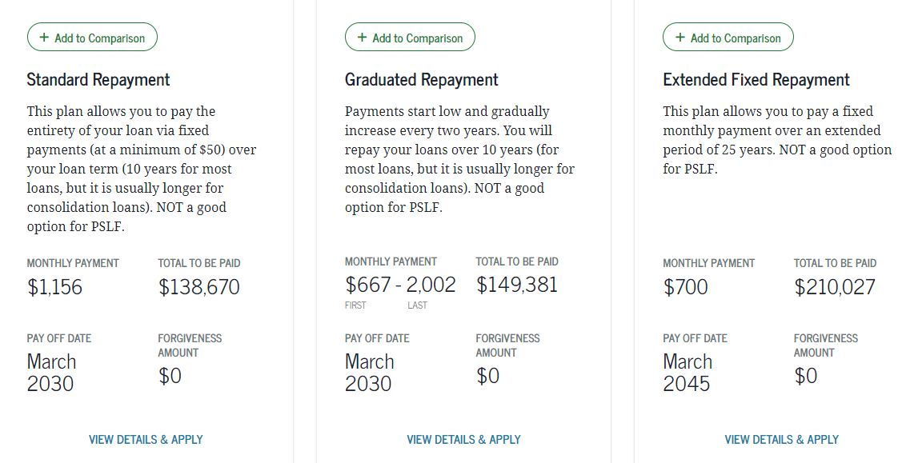
Comparison of Federal Repayment Plans

Slide 43
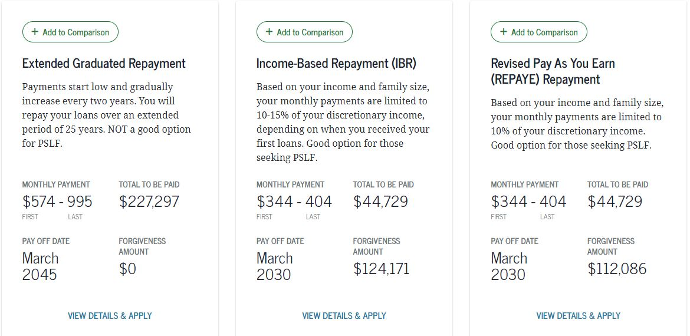
Comparison of Federal Repayment Plans
*
**
*Forgiveness assumed based on PSLFP after 10 years
**This amount should be consistent with IBR and PAYE.

Slide 44
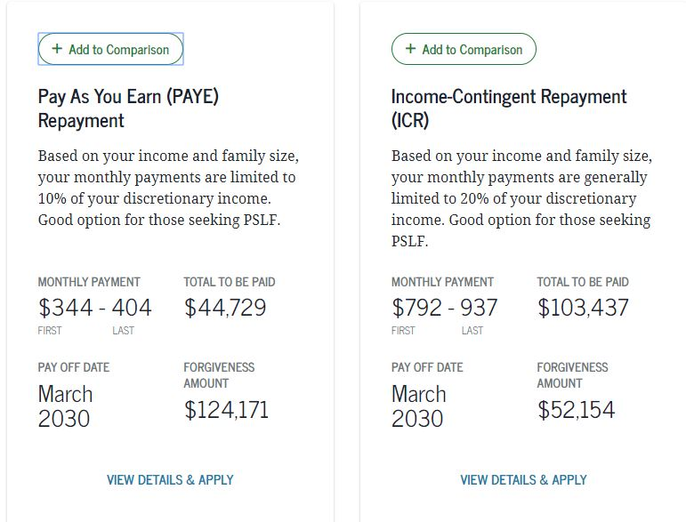
Comparison of Federal Repayment Plans
*
*
*Forgiveness assumed based on PSLFP after 10 years

Slide 45
Lender-Specific Websites
  Citizens – citizensbank.com/student-services
  CollegeAve – https://www.collegeavestudentloans.com/
  Common Bond – commonbond.co
  Discover – discover.com/student-loans
  Earnest – https://www.earnest.com/student-loans
  Laurel Road – laurelroad.com/
  Sallie Mae – salliemae.com
  SoFi – sofi.com
  SunTrust -- aessuccess.org
  Wells Fargo – wellsfargo.com

Slide 46
Repayment Calculators
CBS Grad Year/Program Specific Repayment Calculators (MBA/EMBA)
Standard and Extended Repayment
Prepayment
Federal Repayment Estimator

Slide 47
Default/Delinquency
If you fail to repay (default on) student loans, it can:
Negatively impact your credit rating
Prompt withholding of your federal and state tax refunds
Limit your job selection (many companies run credit checks on job applicants)
Rescind your professional license
Trigger garnishment of your wages
Raise the interest rate you pay on a car or home loan
Personal bankruptcy rarely eliminates student loan debt
Be sure to be in touch with your lender or loan servicer if you are experiencing any issues

